Slide 1
Accounts Receivable
Operations and Reporting in Oracle ERP
Presented by:
Rehab Ahmed Abdelazeem Zewail
Esraa Abdelrheem Mohamdeen Mohamed
Moaaz bellah Ramadan Nassar Elsayed Mostafa
Mohamed Essam Aldsoukey
Track:
ERP (Oracle Digital Accounting Specialist)
Group Code:
NEXT30_ONL1_ERP_G1e
Supervisor:
Eng. Ahmed Maged

Slide 2
Introduction
What are Accounts Receivable in ERP?
The accounts receivable (AR) component of an ERP system deals with invoices owed and incoming payments from customers. The system helps finance teams record payments, send invoices and consolidate data from invoices, and match and track customer payments and outstanding balances.
Presentation Overview:
An overview of the main window used in the module (Transactions) and its main components.
Steps to enter a transactions
How to create new Source
How to create new Transaction Type
How to create new Payment Term
How to create memo lines
How to open and close periods
How to create and maintain a customer
How to Merge Account
Steps for Party Merge
How to define new Item
How to define new Carrier
How to create Transaction Batch
How to Print Invoices
Credit-Memo invoices (2 ways)
How to create Deposit invoices
How to create Guarantee invoices
How to create Accounting Rules
How to create Invoice Rule
How to place a discount on a specific client
Adjustment methods

Slide 3
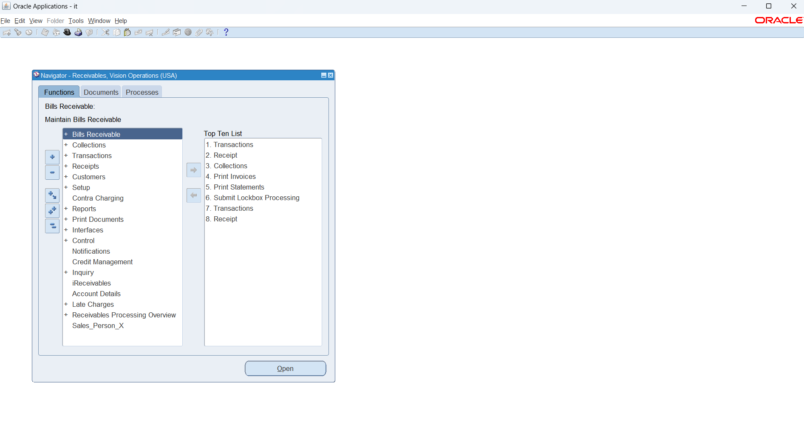
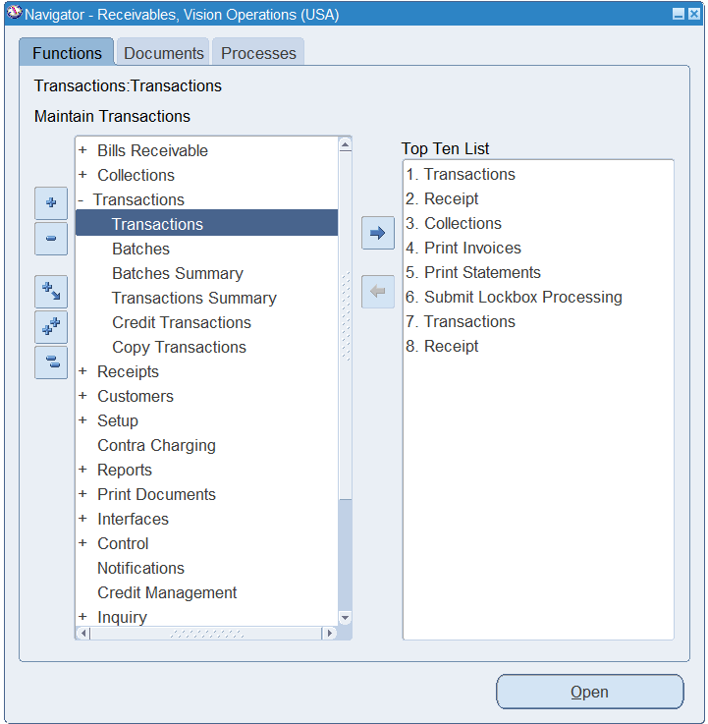
*First Step is to Choose the “ Receivables” module from the legal entity’s responsibilities.
to open the transaction window:
1. Transactions
2. Transactions

Slide 4
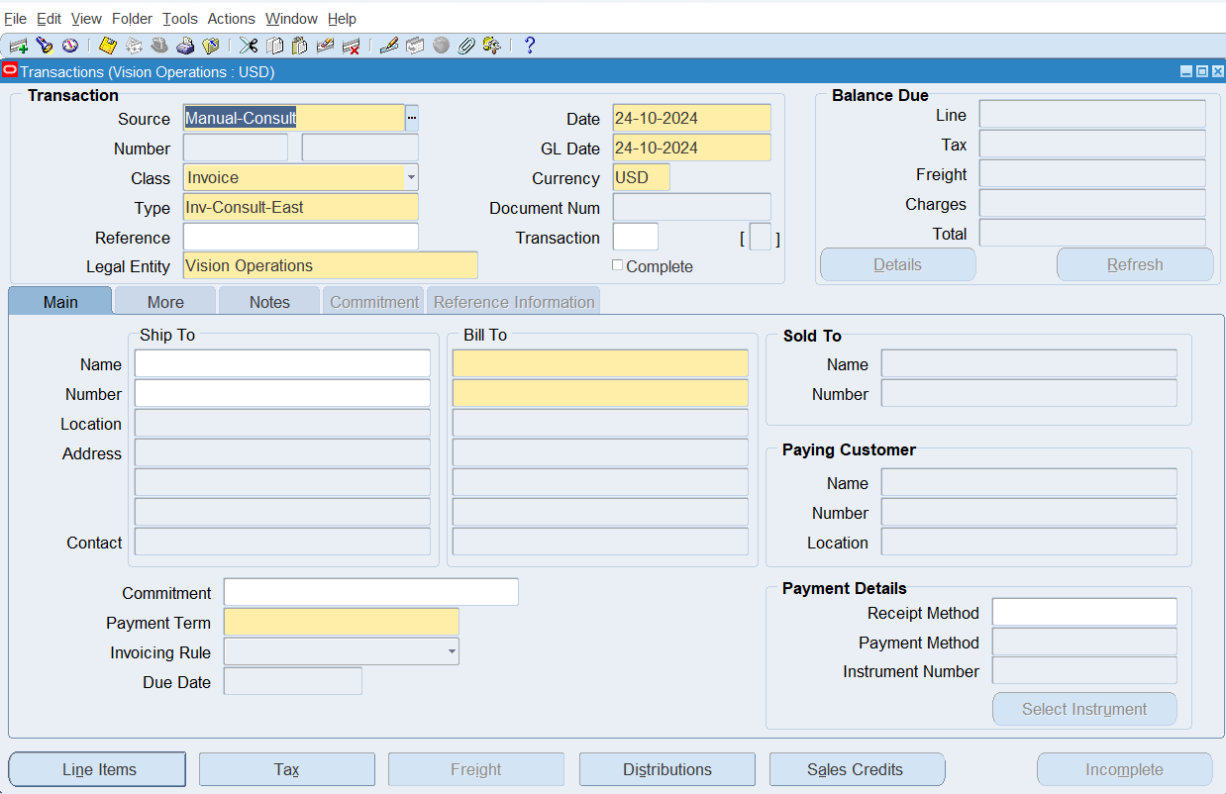
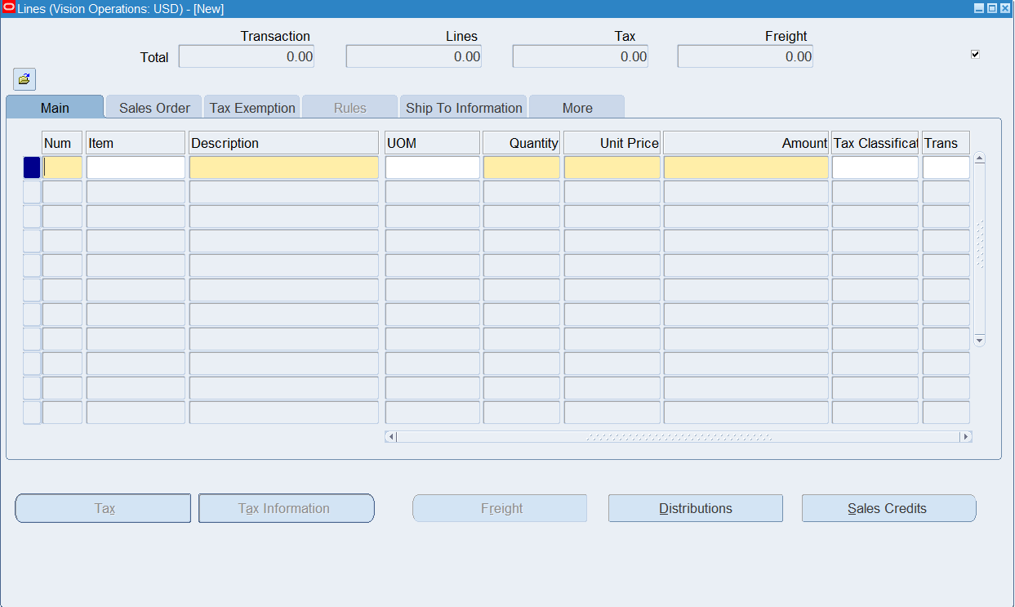
It Contains:
1. Header:
It contains the details of the transaction
And customers data.
2. Line Items:
A window to put the items details in
( description, UOM, Quantity, price,…)
Distribution:
Show the Revenue Account that used in the Journal.
Tax:
Shows the Tax Applied to the Transaction.

Slide 5
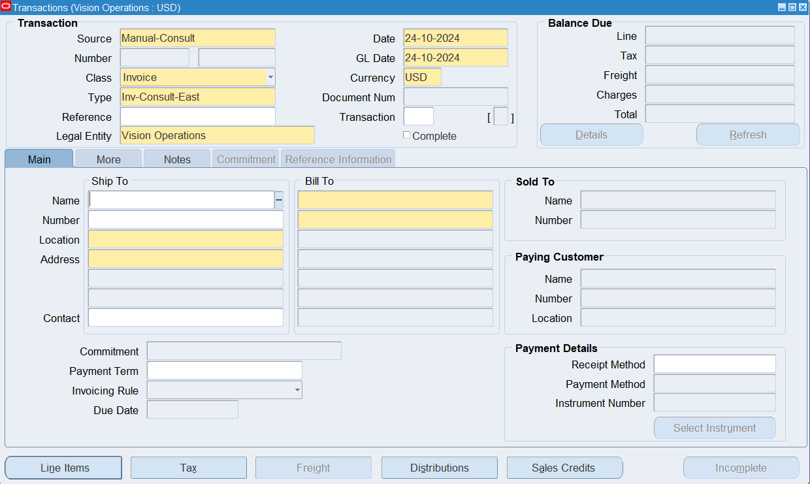
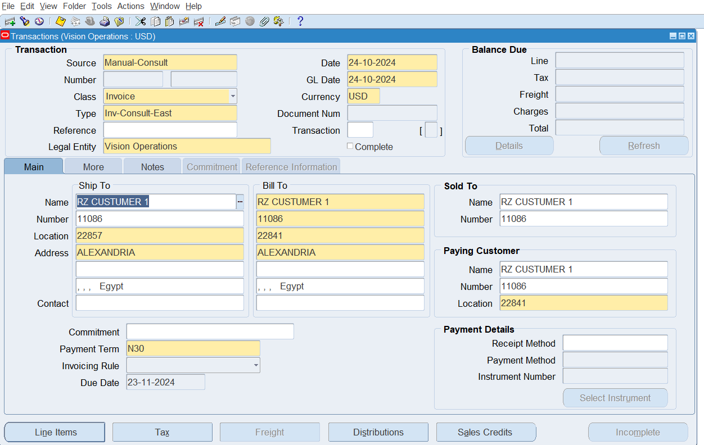
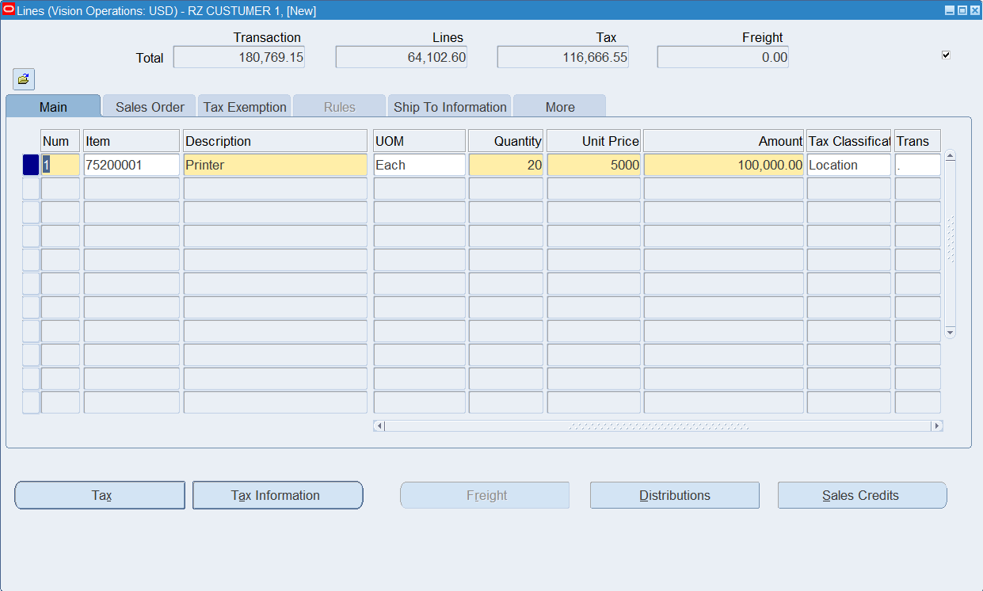
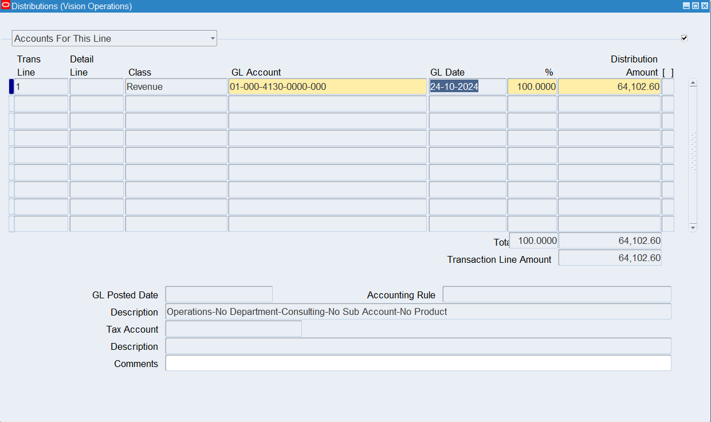
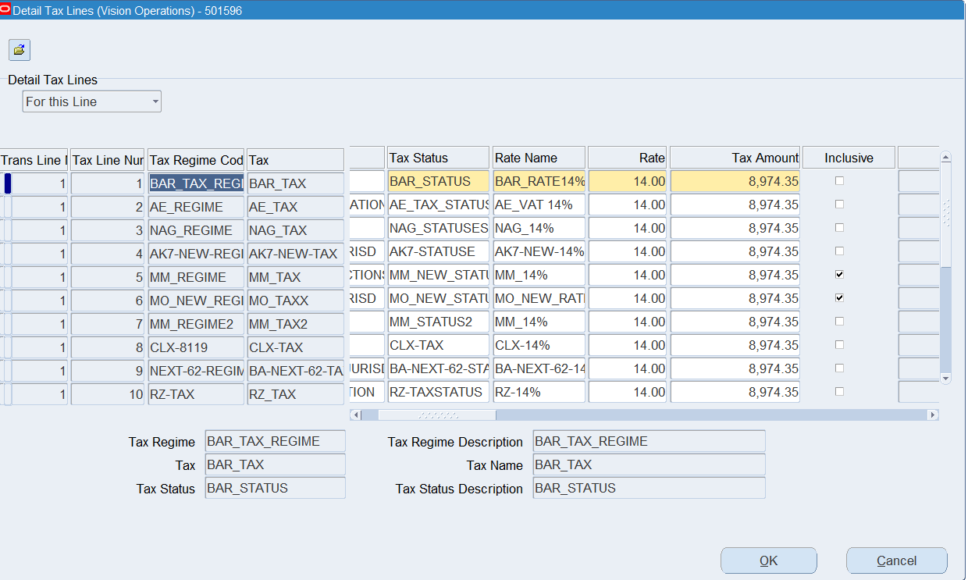
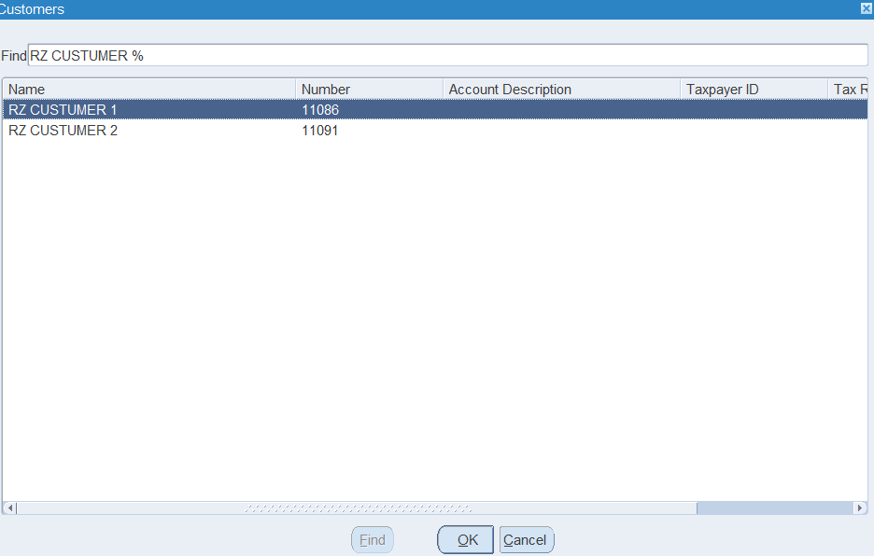
Steps to enter a transactions:
1. open the pass as previous ( transactions transactions)
2. Choose the customer's name
(RZ CUSTOMER 1 as an Example)
3. Open Line Items
(and enter the items’ data)
*Open Distributions
(to view the Revenue Account)
*Open Tax
(to view the tax applied on the bill)
4. Save the transaction

Slide 6
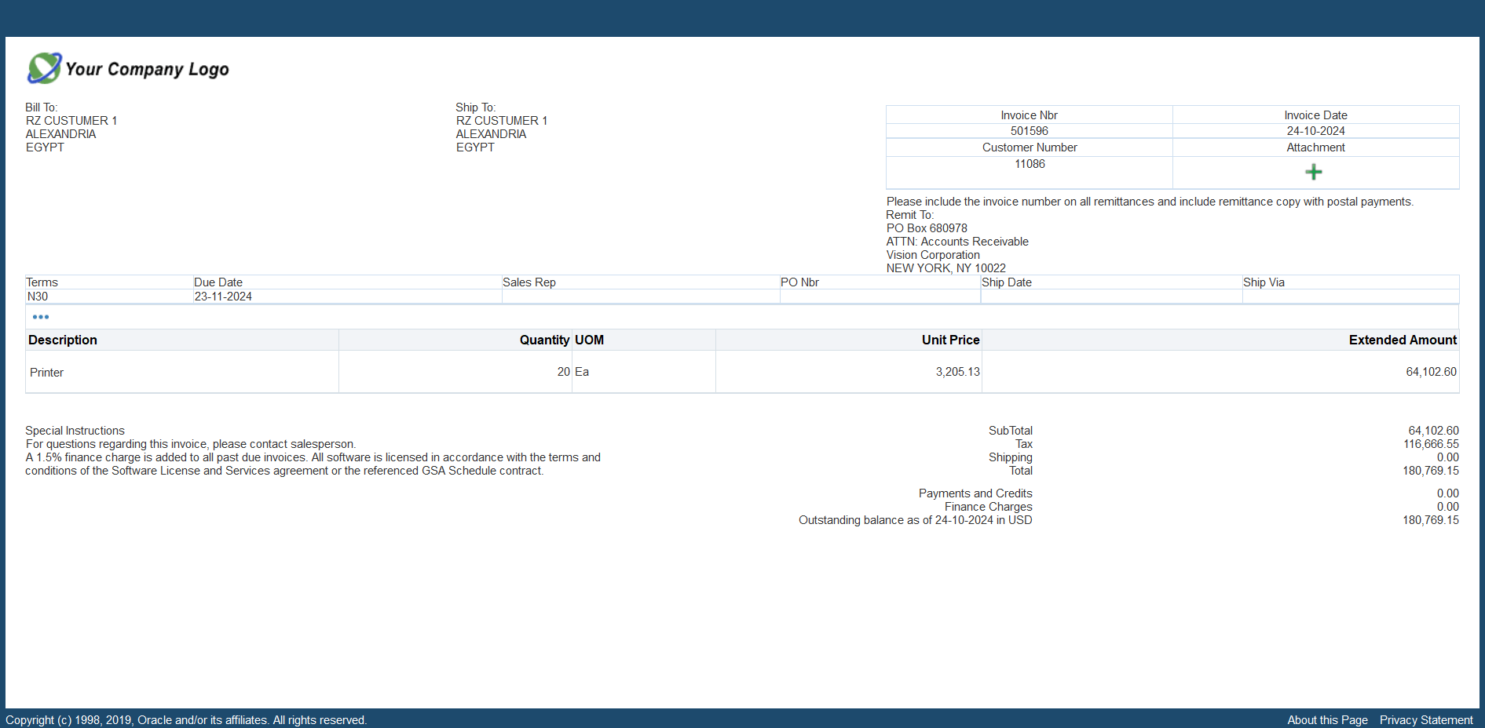
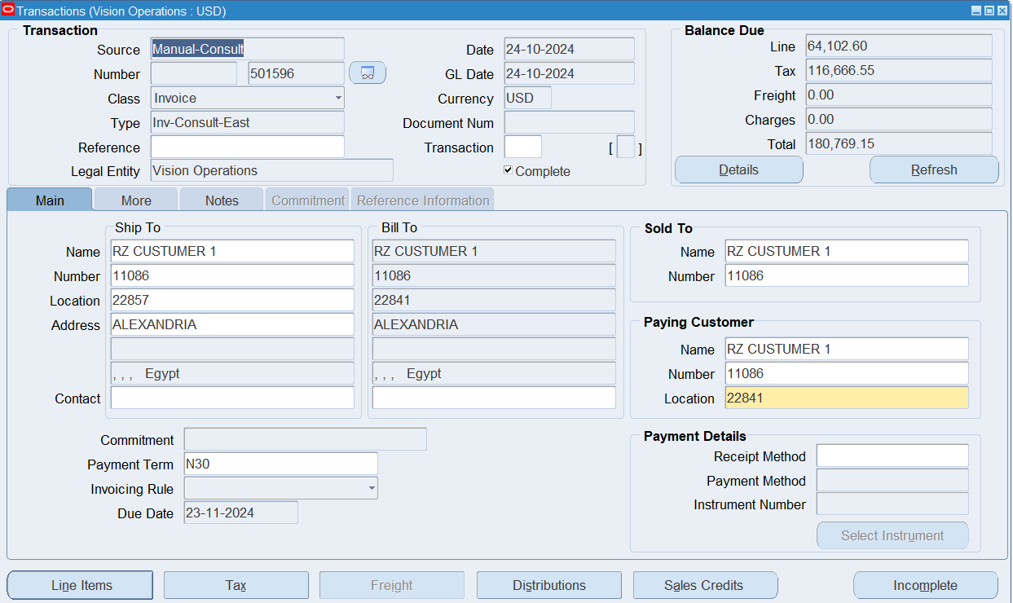
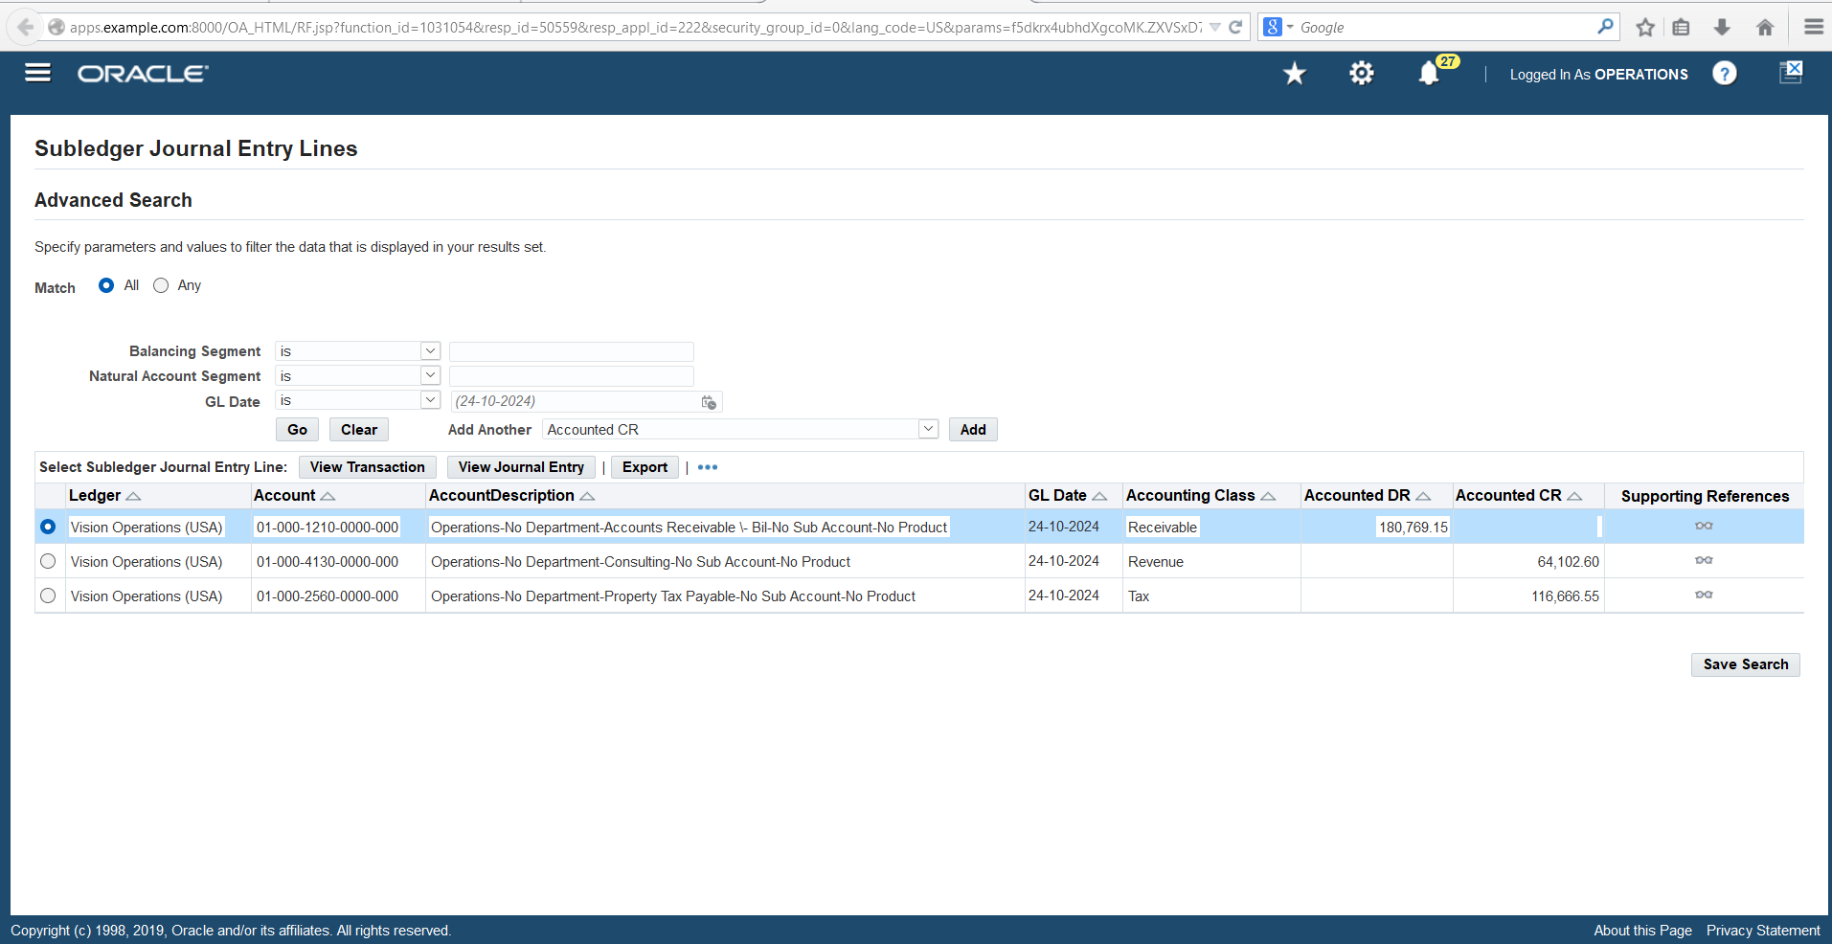
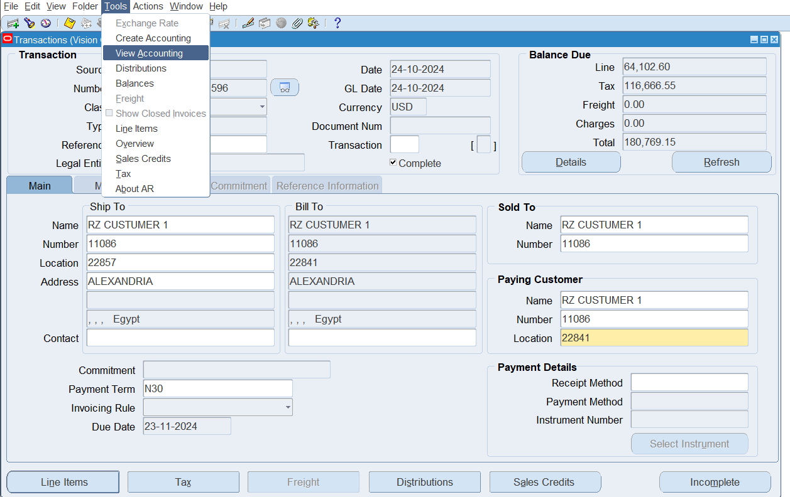
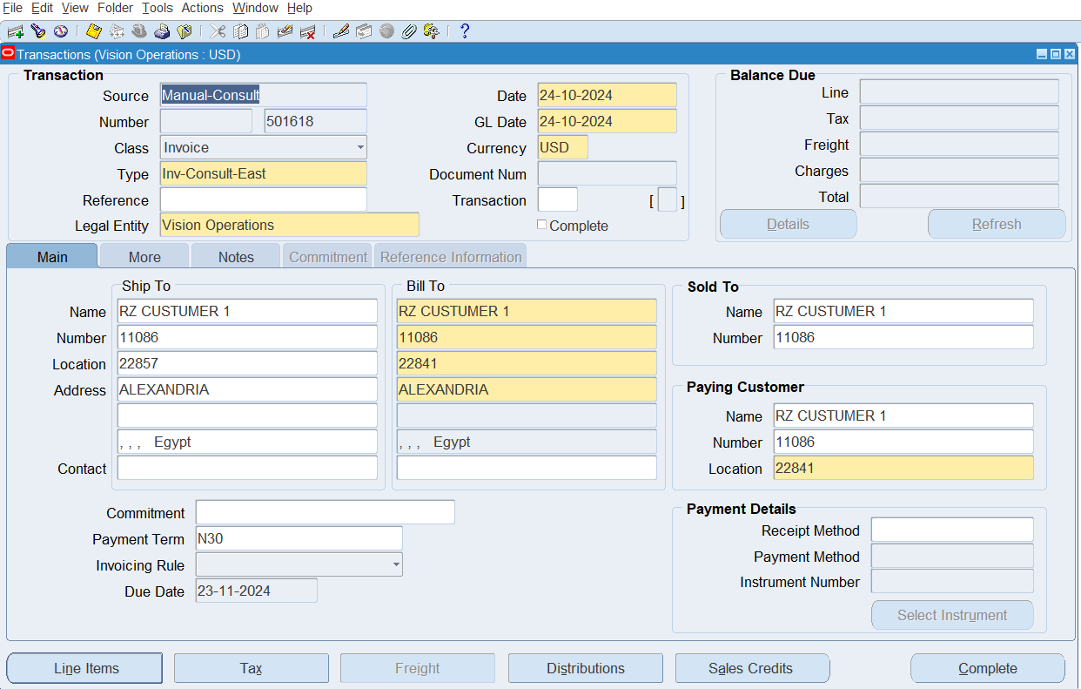
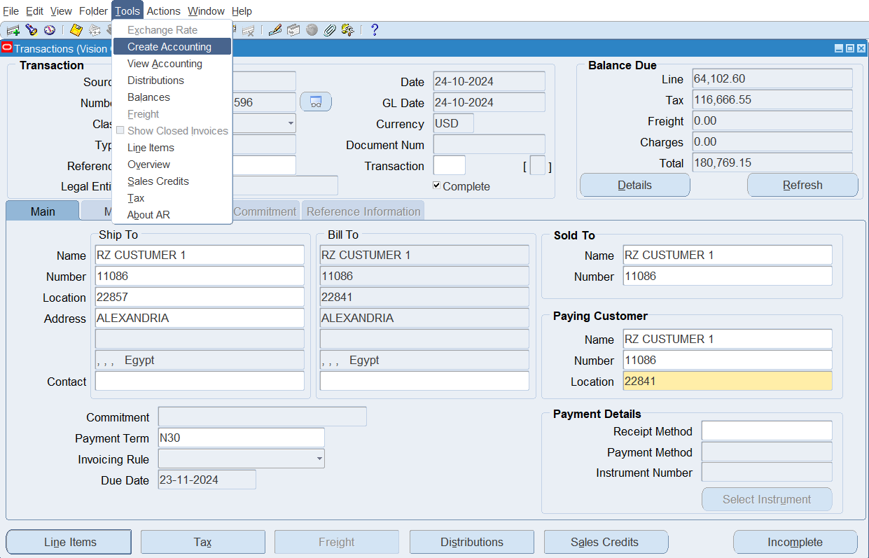
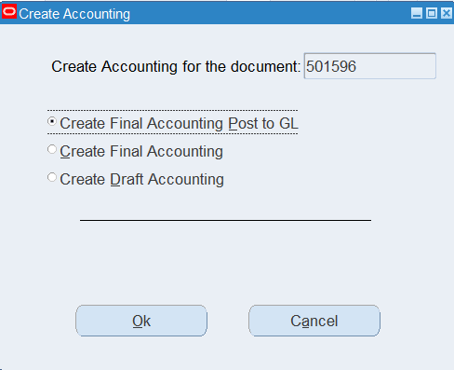
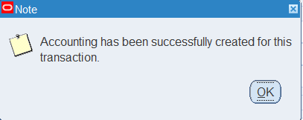
5. Press complete
6. From Tools in the menu bar
choose Create Accounting to post the transaction
*From tools
Choose view Accounting to view the journal entry
*To view the Bill
Press the button besides Transaction number

Slide 7
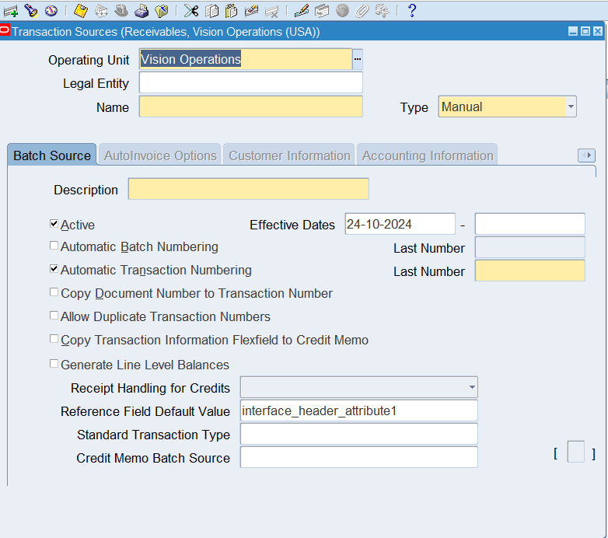
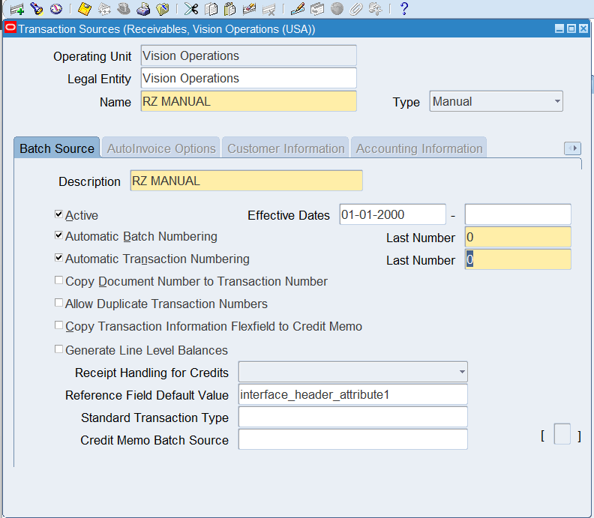
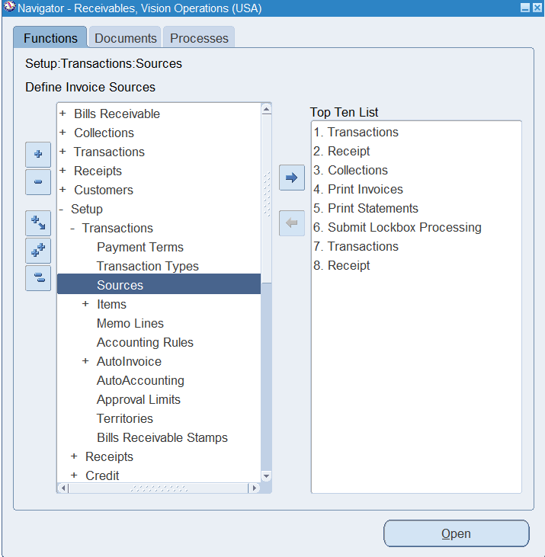
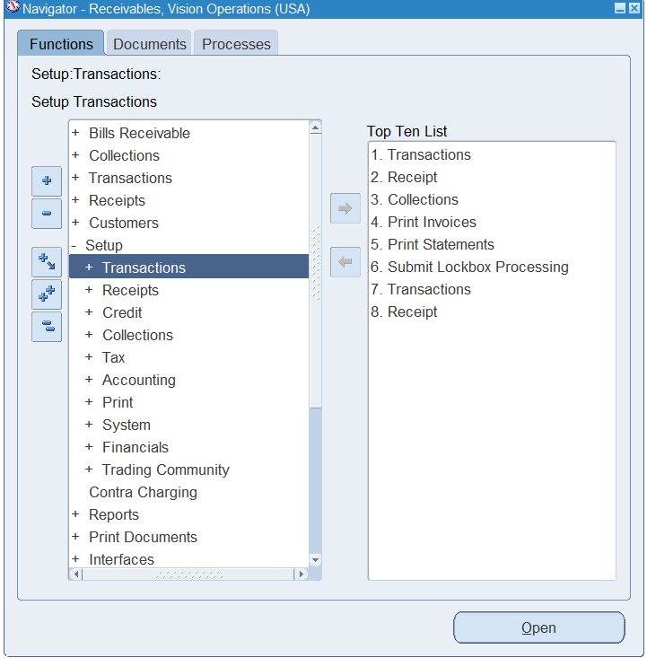
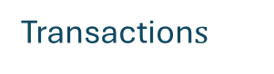
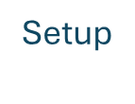
How to create new Source
1. From the navigator select:
Setup
Transaction$s$
sources
2. Fill source data
(RZ MANUAL as an Example)
3. Save the source.

Slide 8
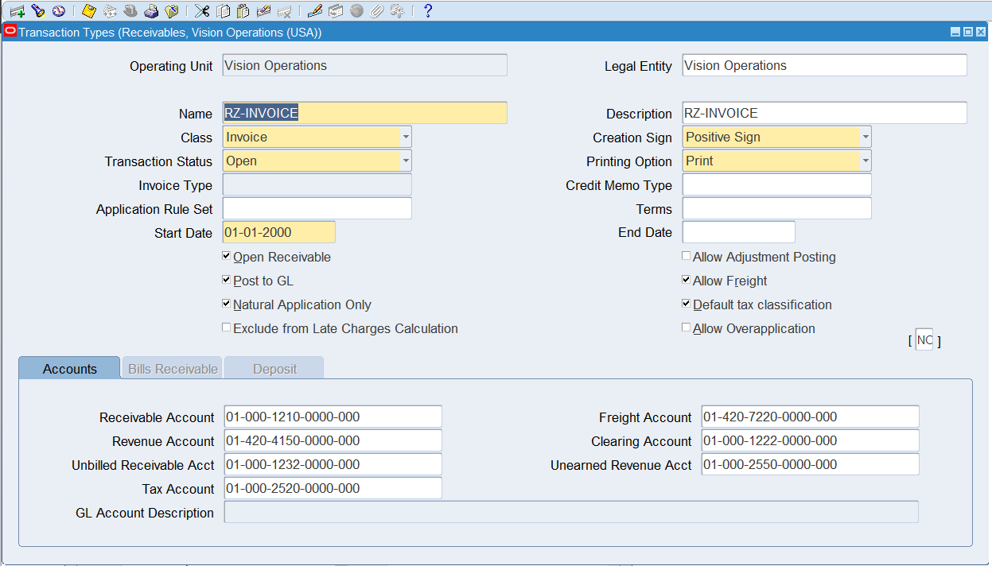
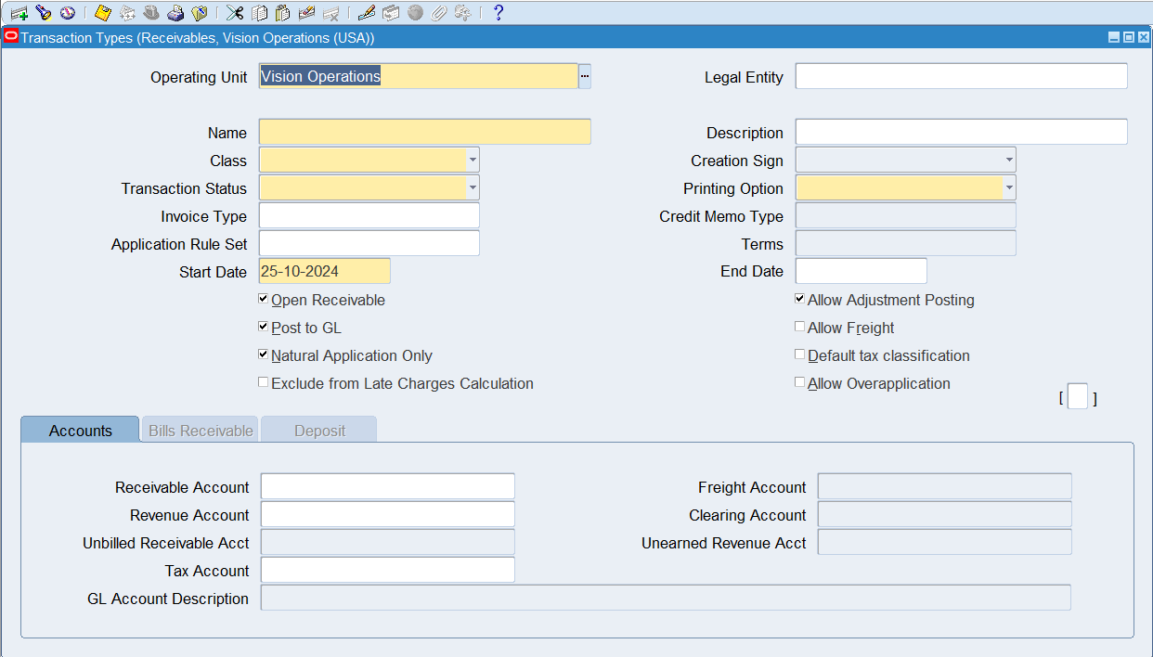
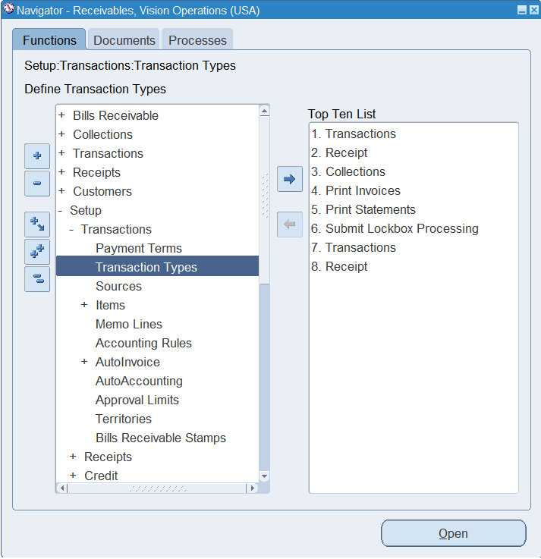
How to create new Transaction Type:
1. From the navigator select:
Setup
Transaction$s$
Transaction types
2. Fill source data
(RZ- INVOICE as an Example)
3. Save the Type.

Slide 9
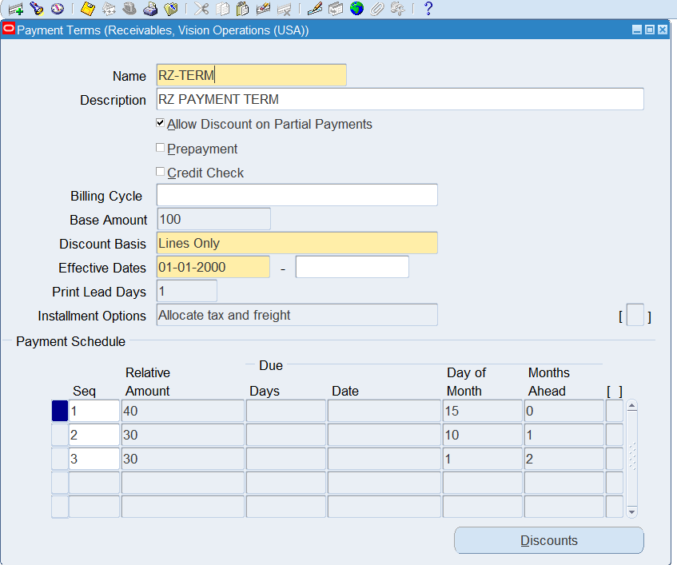
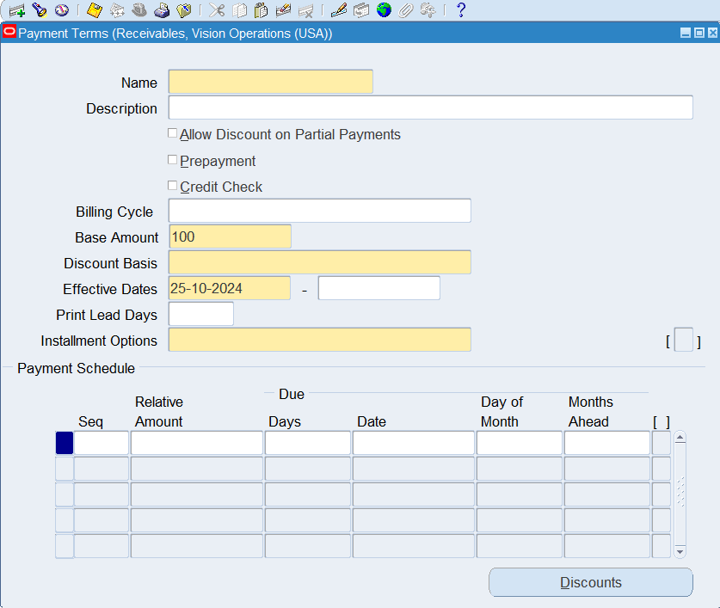
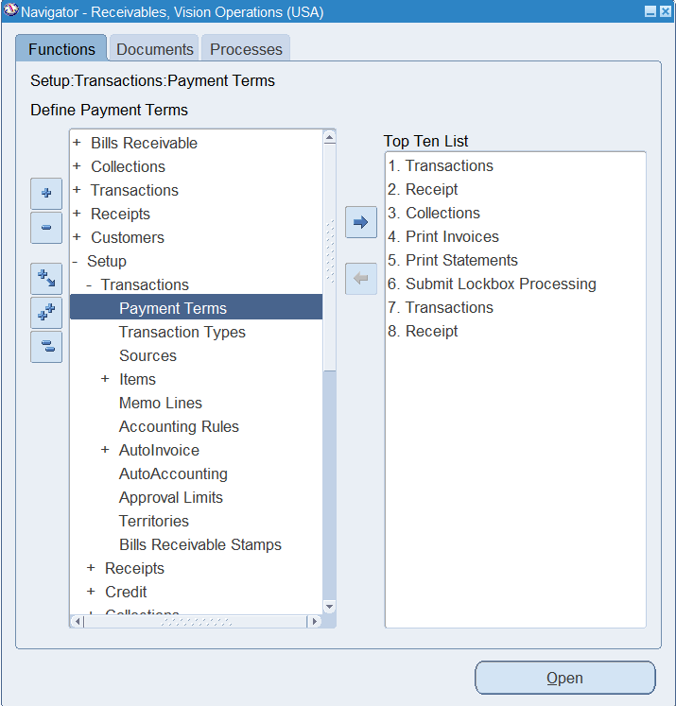
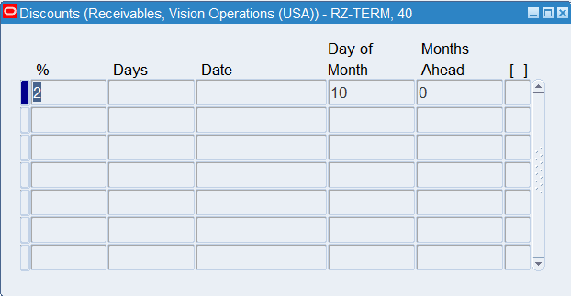

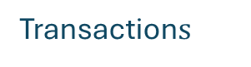
How to create new Payment Term:
1. From the navigator select:
Setup
Transaction$s$
Payment Terms
2. Fill Payment Term data
(RZ- TERM as an Example)
* You can add discounts on the payment
(Press discounts and fill the data)
3. Save the Term.

Slide 10
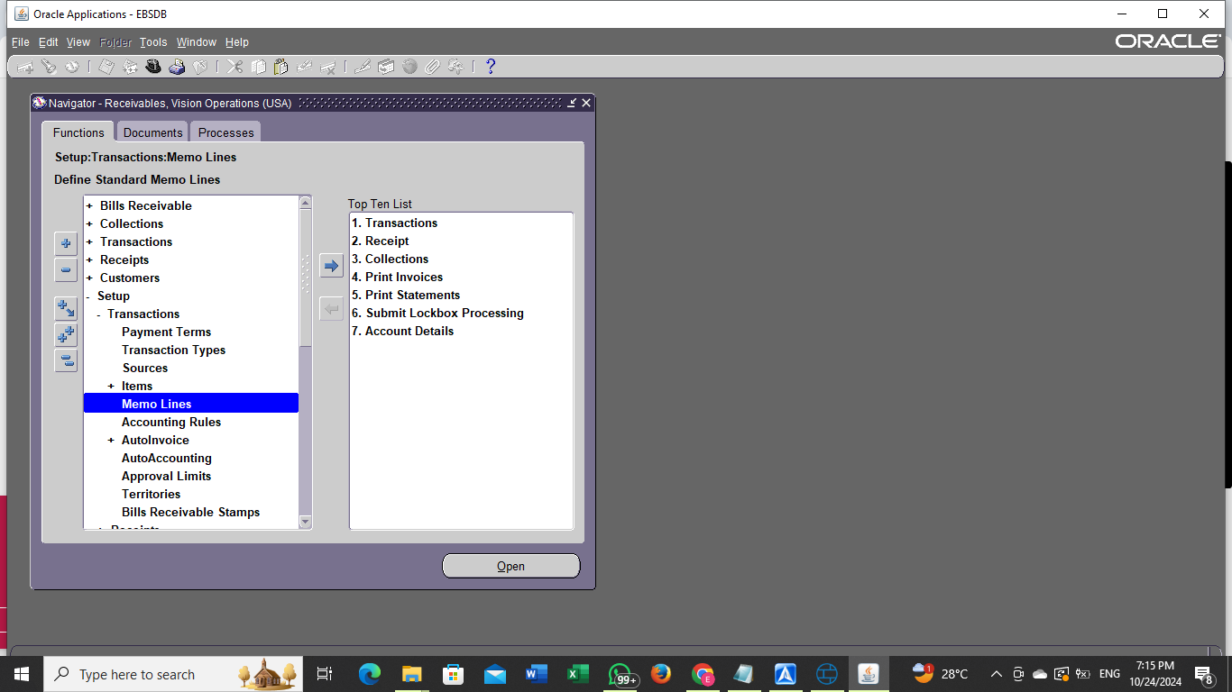
How to create memo lines:
Navigator > Accounts Receivable > Setup > Transactions> Memo Lines.

Slide 11
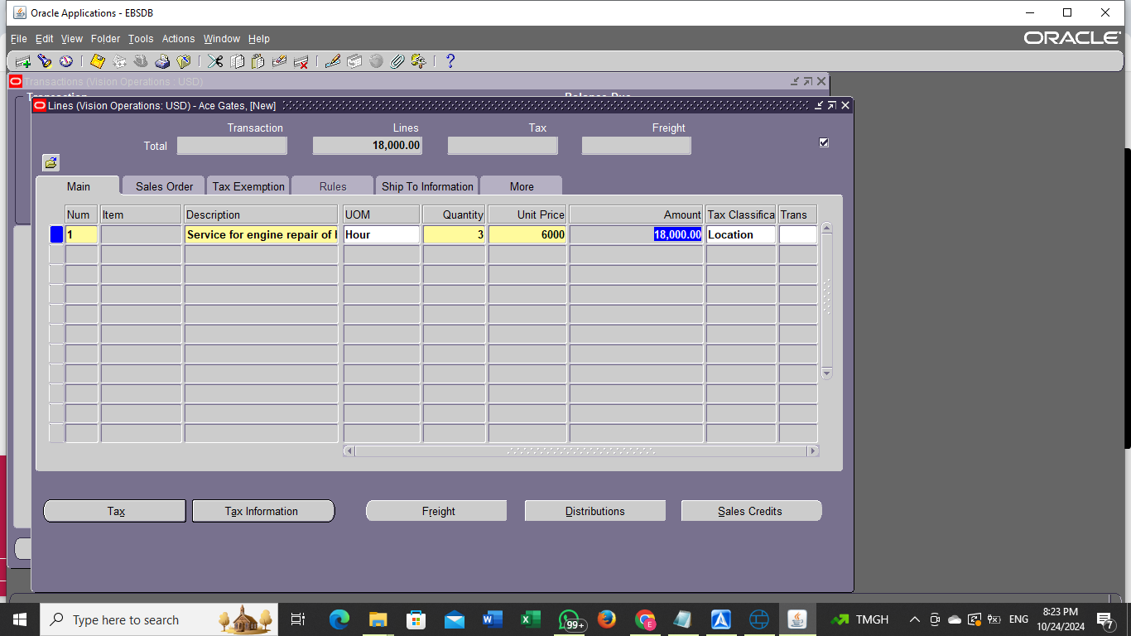
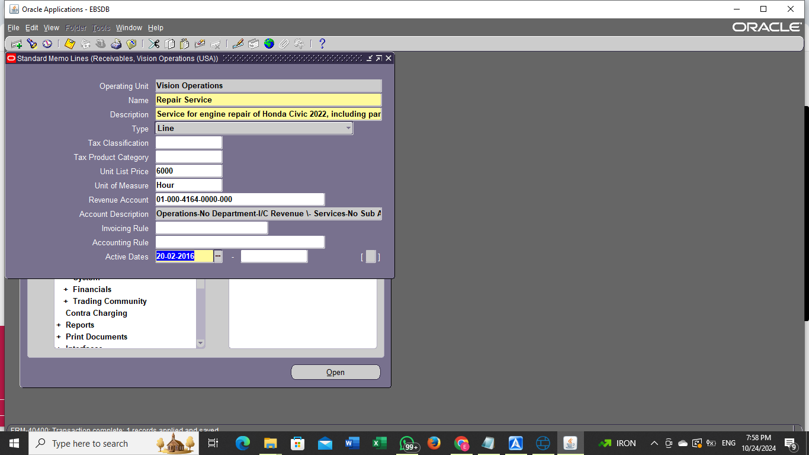
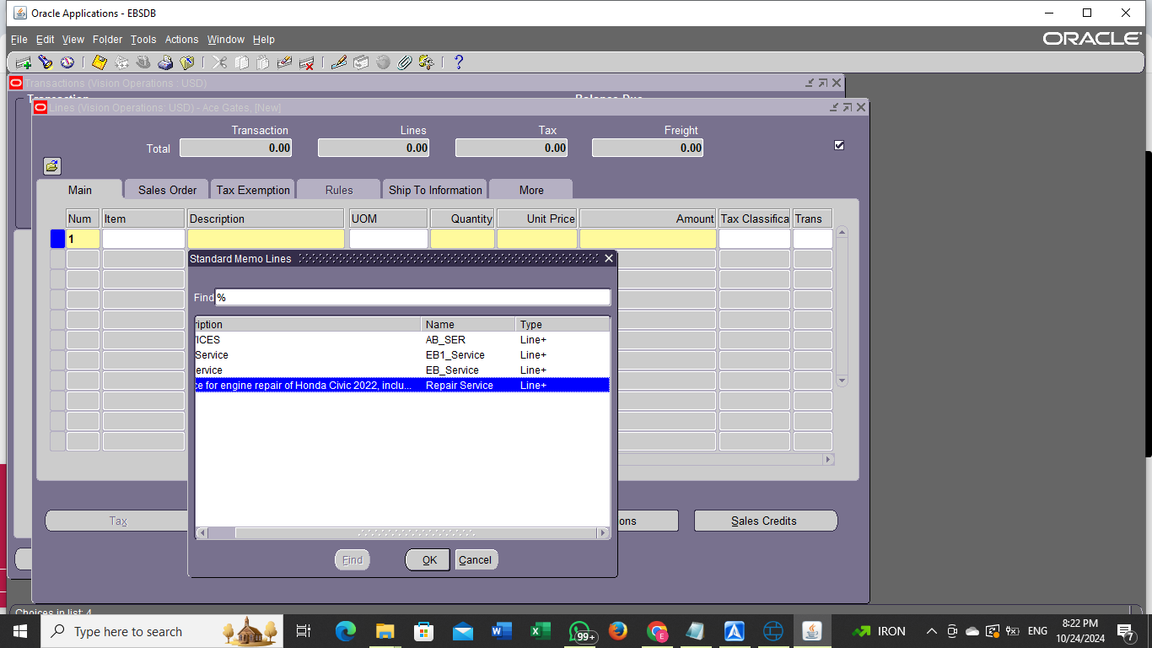
Explanation of the Memo Line Setup
1. Service Selection:
I selected the service "Repair Service" as part of the automotive project. This service is related to providing vehicle repair services to customers.
2. Description:
I provided a detailed description for the service: "Service for engine repair of Honda Civic 2022, including part replacement." The purpose of this description is to clarify the type and details of the service being offered.
3. Unit of Measure:
I chose "Hour" as the unit of measure, where the cost of the service is calculated based on the number of hours spent on the repair.
4. Price Definition:
The cost per hour was set at 6000, so the customer is billed according to the actual number of hours the repair service takes.
5. Saving the Memo Line:
After entering all the required data, I saved the Memo Line, making it ready to be used for invoicing related to the repair services.

Slide 12
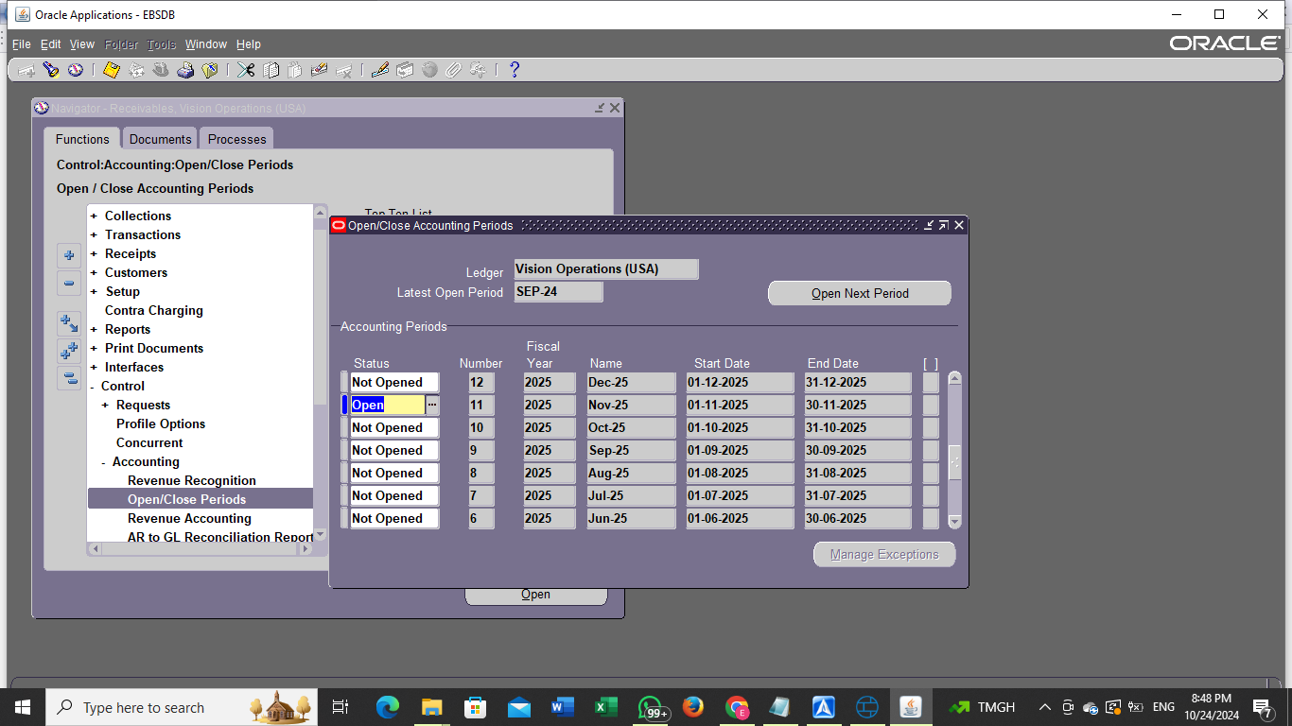
How to open and close periods:
Navigator > Accounts Receivable > Control > Accounting > Open/Close Periods.

Slide 13
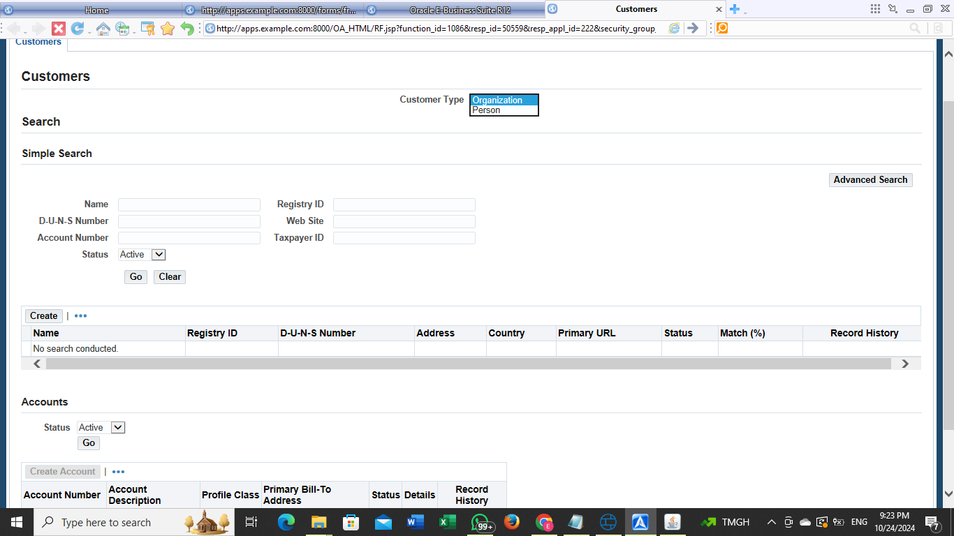
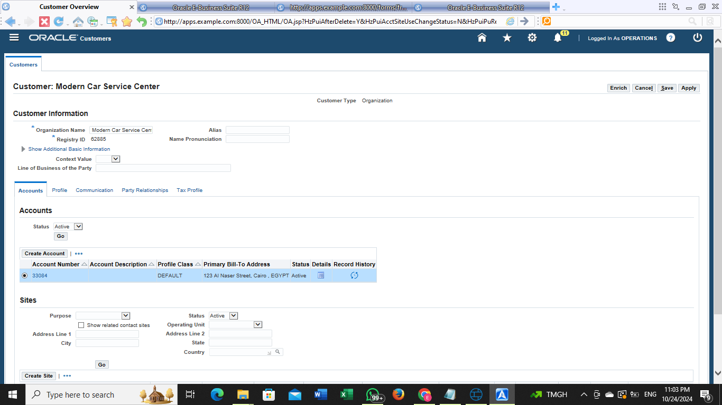
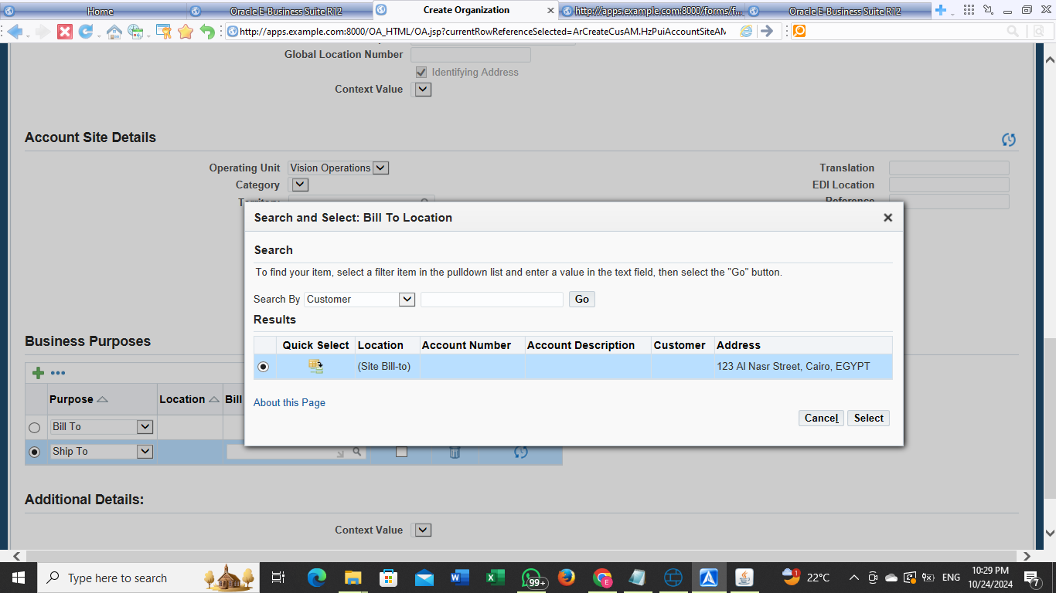
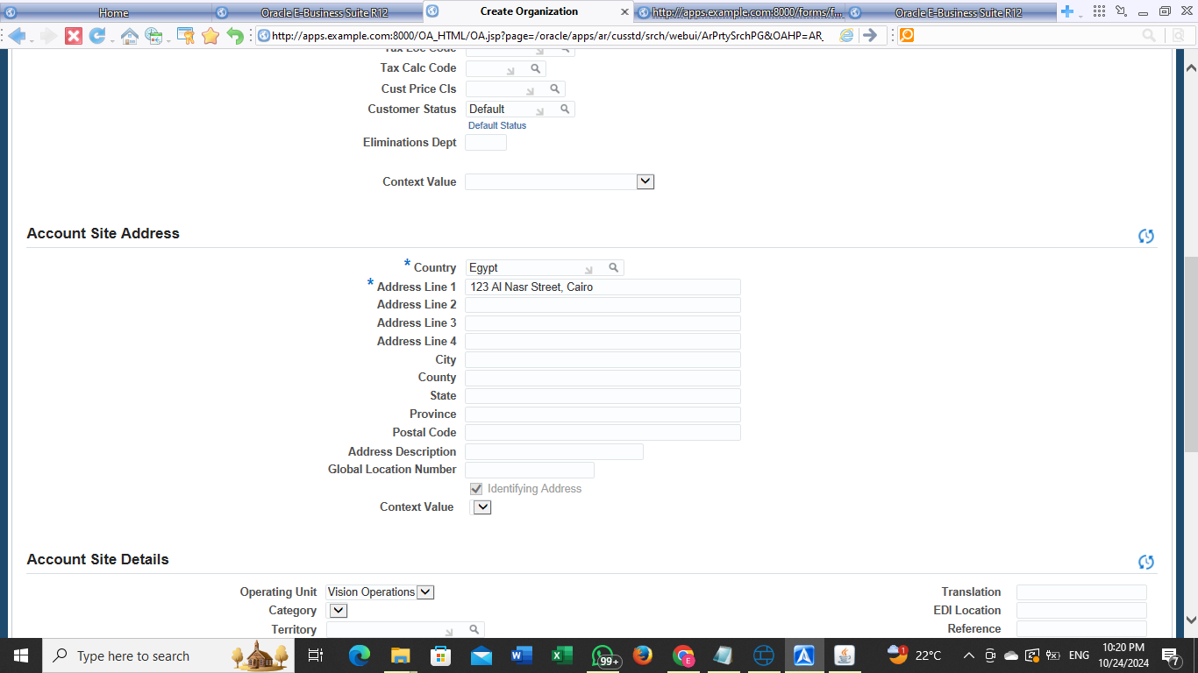
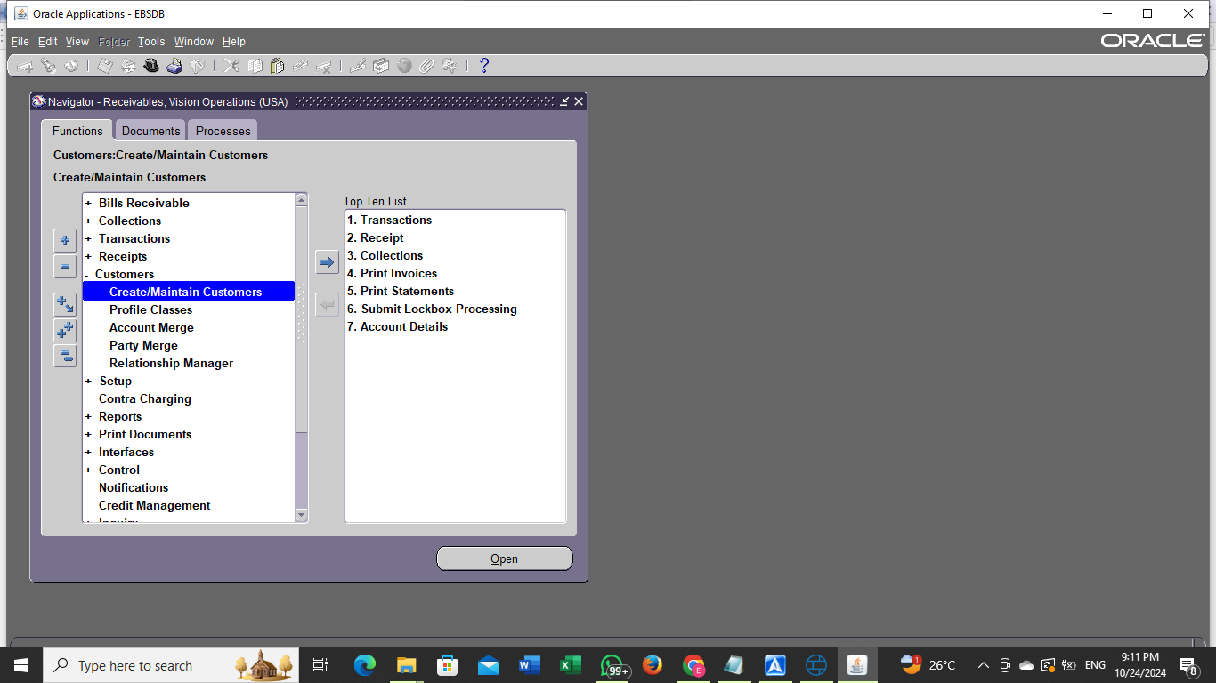
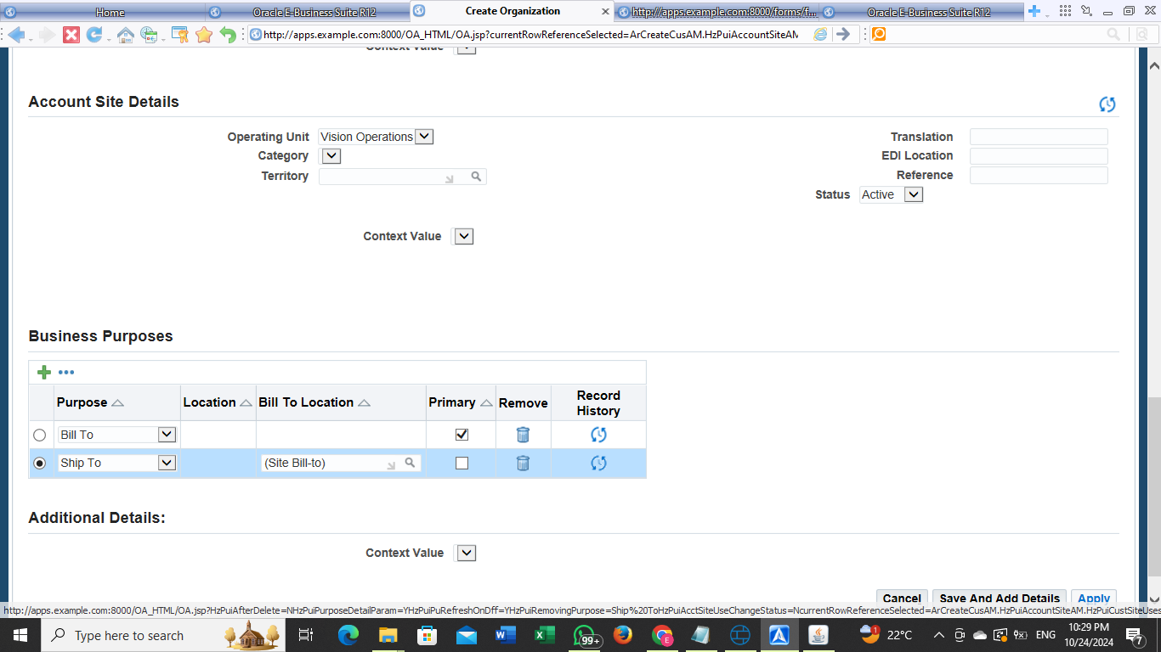
How to create and maintain a customer:
Navigator > Accounts Receivable > Customers > Create and Maintain Customers.
1. Press create
2. Enter Customer Details:
Customer Name: Enter the customer’s name (Modern Car Service Center").
Customer Type: Select the customer type (Person or Organization).
Address: Enter the full customer address .
Contacts: Enter contact information (such as phone number and email).
3. Save Data :
After entering all the required information, click Save to save the customer’s details.
4. Maintain Customer:
After creating the customer, you can return to this section to modify or update the information .
Choose Search Customer, then search for the customer using the name or customer ID .
Once you find the customer, select Edit to make the necessary changes .
Save the changes after editing

Slide 14
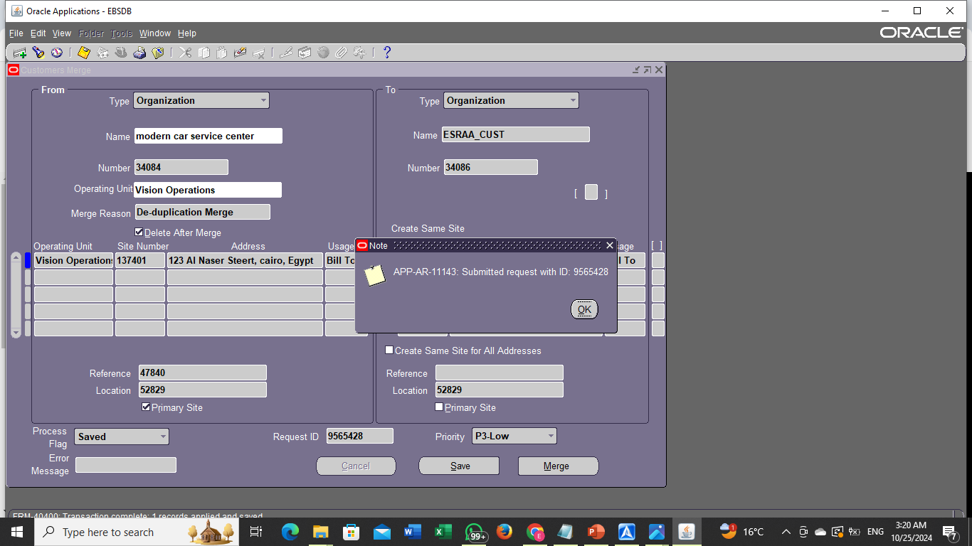
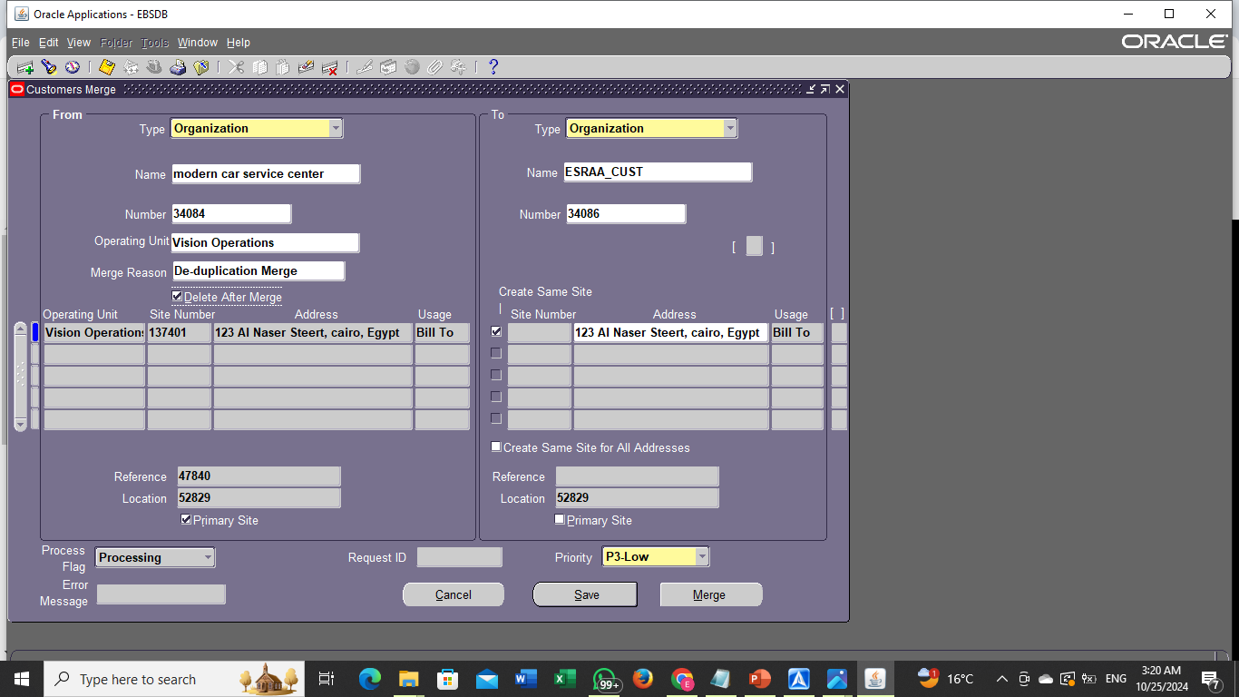
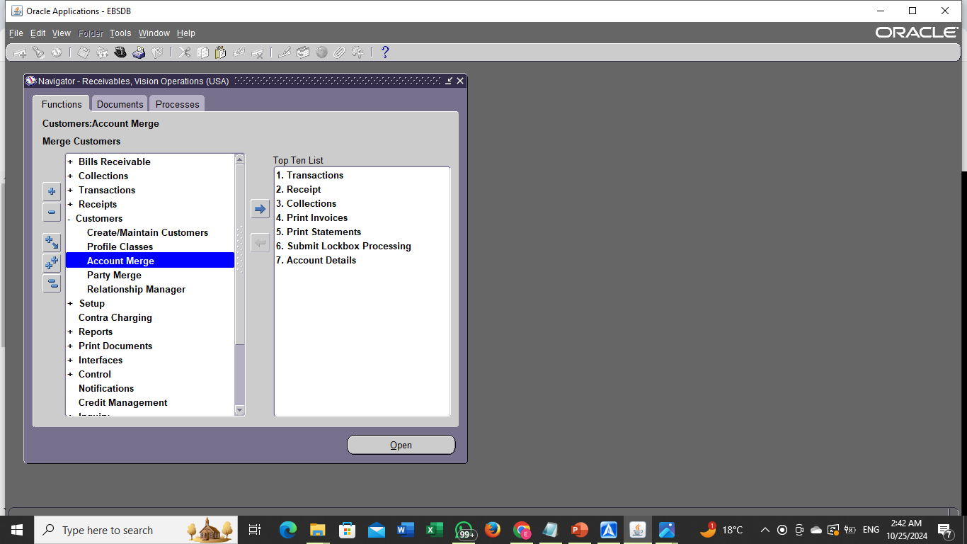
How to Merge Account
Navigator > Accounts Receivable > Customers > Account Merge.
Select Accounts to Merge:
In the Merge Accounts screen, enter the From Account (Modern Car Service Center) and the To Account (Esraa_Cust), click on Merge to initiate the process.

Slide 15
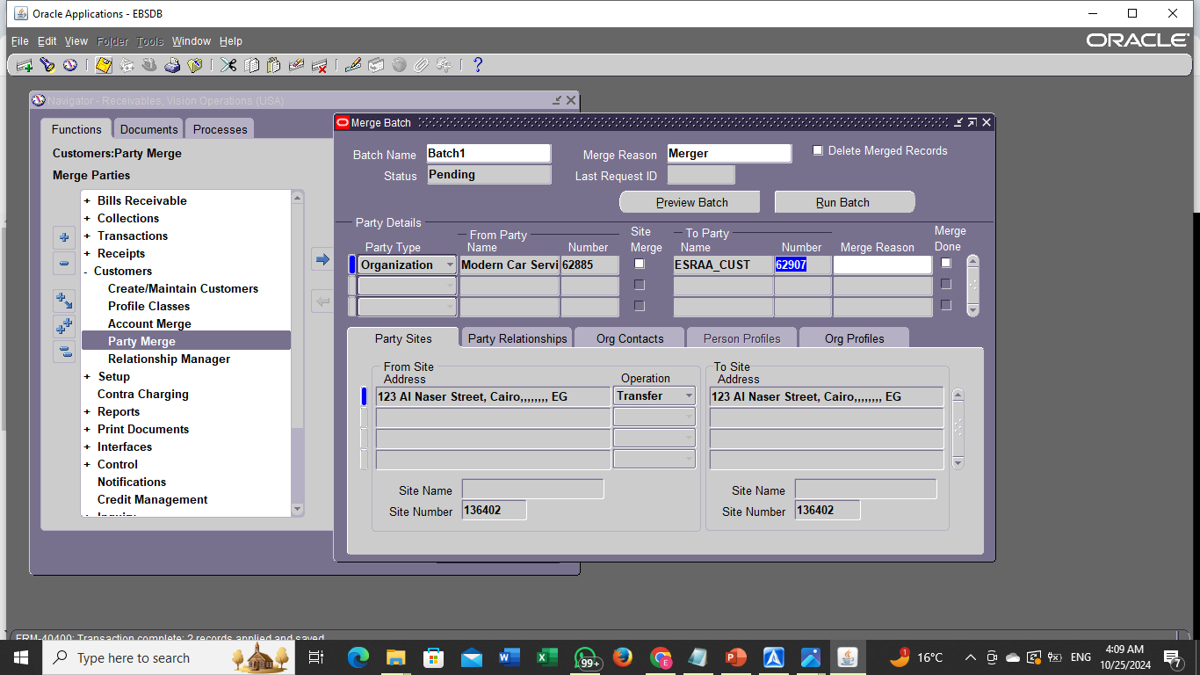
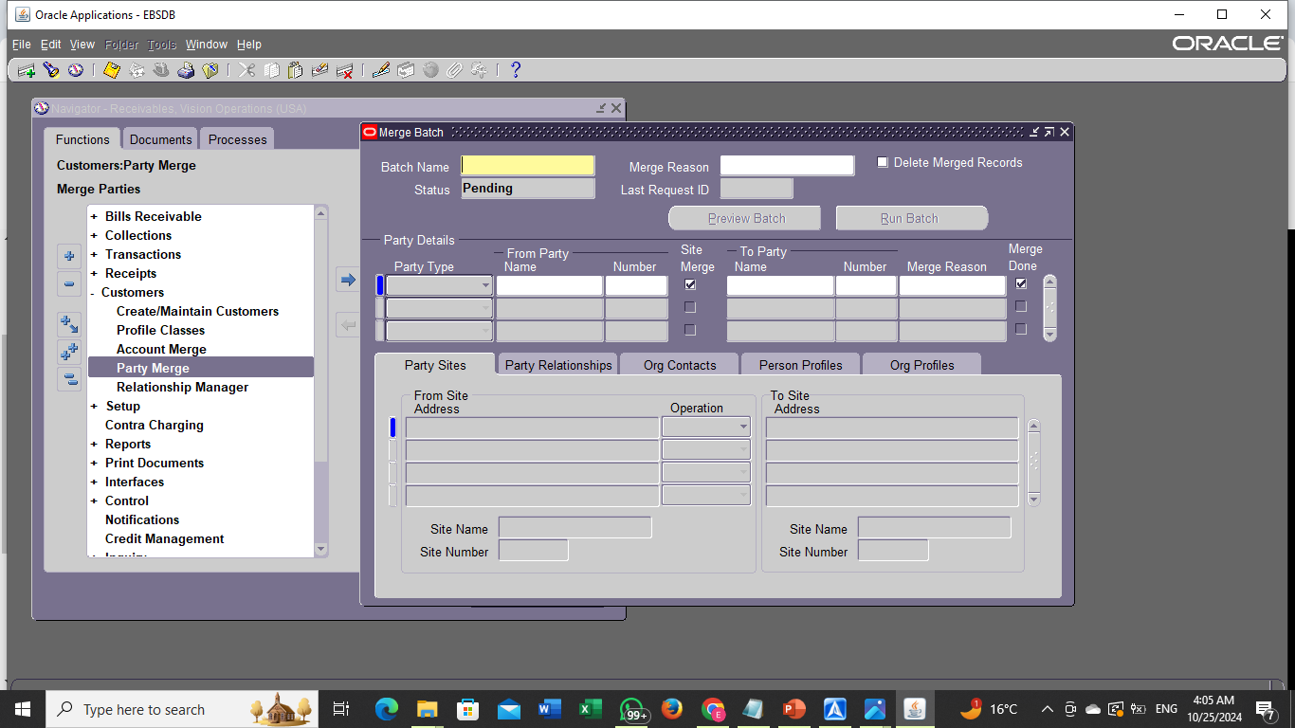
Steps for Party Merge:
Navigator > Accounts Receivable > Customers > Party Merge.
Select the customer From Party (the customer to be merged) and To Party (the customer to be retained).
SAVE , Then Click on Run Batch.

Slide 16
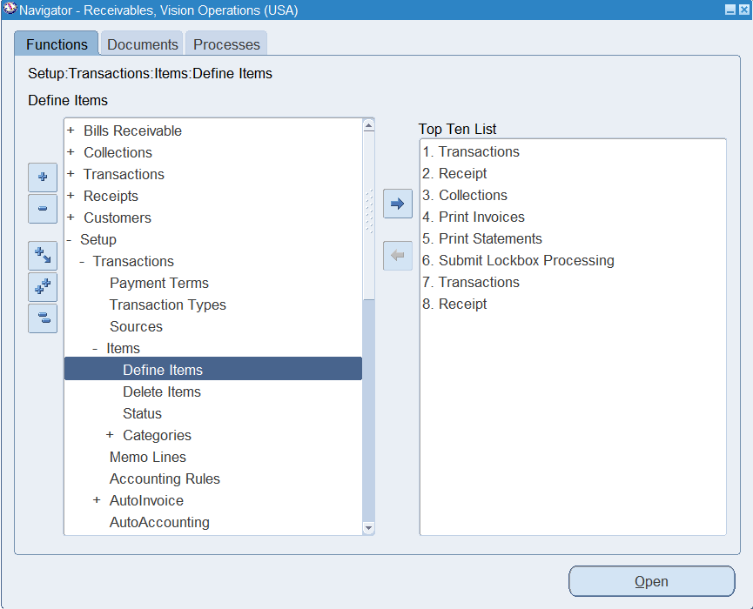
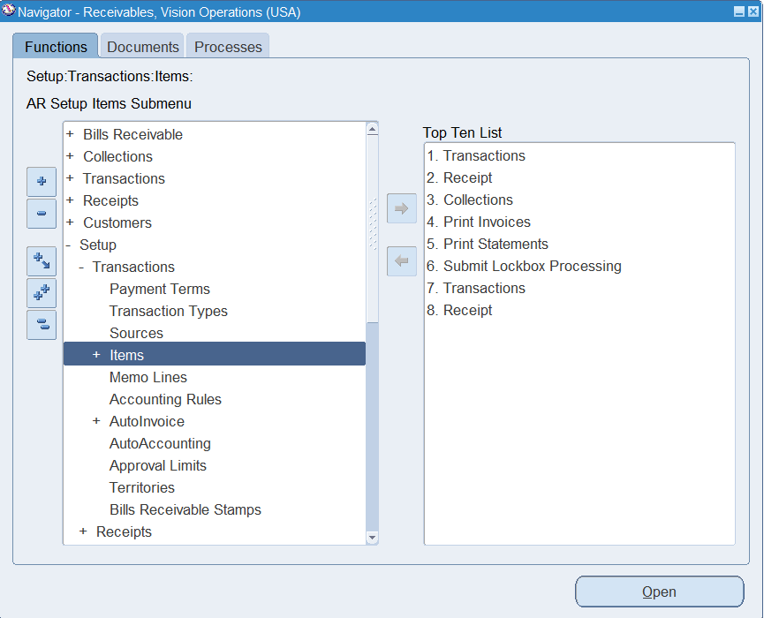






How to define new Item:
1. From the navigator select:
Setup
Transaction$s$
Items
D$efine items$
2. Choose the organization
(vision operation as an Example)
3. Give it a name and description
(RZ-ITEM as an Example)
4.From tools select copy from
(to copy data from another item)
5.Select the item you want to copy it data, press done.
6. Save the Item.

Slide 17






How to define new Carrier:
1. From the navigator select:
Setup
S$ystem$
Quick codes
Fright carrier
2. Put the Carrier name and select the details
3. Click Organization Assignment and choose your legal entity, click Done.
3. Save the carrier.

Slide 18



How to create Transaction Batch:
1. From the navigator select:
Transaction
Batch
2. Select the source and other data
3. Click Transactions and create Transaction as usual.

Slide 19












How to Print Invoices:
1. From the navigator select:
P$rint document$
Invoices
2. Click ok to run the request
3. Choose the Report.
4. Put the data of the invoice you want to print, click ok.
5. Submit the request
6. Go to Request and wait till the request completes
7. Click on the request, then press View output

Slide 20




simple way for credit memo
Create regular invoice.
Insert the main information.
Insert the lines of the invoice.
Press save.
Press complete.
Press tools from the top toolbar.
Press create accounting.
Choose final post.
Press ok.
Press actions from the top toolbar and choose credit.
Insert the main information (date, gl date, type) in the window which will open.
Press in front of credit allocations and choose lines only.
Insert the percentage of the needed credit or the amount of it (with negative sign).
Press save, press complete, press tools then create accounting final post.

Slide 21



Invoiced credit memo
to make transaction type for credit memo:
From the navigator go to >setup >transactions > transaction types.
Insert the main information and choose the sign negative then insert the needed accounts.
To make an invoice to apply the credit memo to it, Go to transactions screen and create a regular invoice and insert the main information.
Go to the lines tap and insert the invoice lines and press save.
Go back to the transactions screen and press complete then press tools from top toolbar and choose create accounting then choose final post and ok.

Slide 22



Invoiced credit memo (continue)
create a transactions in class of credit memo and insert credit memo transaction type we made before and insert the exact customer engaged with last regular invoice we created.
Go to lines tap and put the credit value in negative sign then press save.
Go back to the transaction screen and press complete and press actions from the top toolbar then choose applications.
In the window which will open press under apply to choose the invoice you need to apply the credit to, put the date and gl date then press save and go back to create accounting final post.

Slide 23



Deposit transactions:
First creating deposit transaction like the way we created the credit memo type.
Go to transactions main screen to create an invoice in the class of deposit and insert the deposit transaction type we created, insert the main information needed in the screen.
Go to the commitment tap in the horizontal middle of the screen then put the date and the deposit amount, the item and the description then press save.
Press complete then tools and create accounting final post.

Slide 24




Deposit transactions (continue)
Create a regular invoice in the class of invoice and put the main information, especially the exact customer we used In the deposit invoice.
Put the deposit transaction number in the commitment space in the near bottom of the main screen by pressing on the 3 dots beside it.
Go to lines window and fill the invoice lines.
Go back and press incomplete, tools, create accounting final post.
To view the effect of the deposit transaction press on the refresh button on the top right of the screen then details.

Slide 25



Guarantee transactions:
First creating deposit transaction type like the way we created the credit memo type & deposit type.
Go to transactions main screen to create an invoice in the class of guarantee and insert the guarantee transaction type we created, insert the main information needed in the screen.
Go to the commitment tap in the horizontal middle of the screen then put the date and the amount of guarantee, the item and the description then press save.
Press complete then tools and create accounting final post.

Slide 26



Guarantee transactions (continue)
Create a regular invoice in the class of invoice and put the main information, especially the exact customer we used In the guarantee invoice.
Put the guarantee transaction number in the commitment space in the near bottom of the main screen by pressing on the 3 dots beside it.
Go to lines window and fill the invoice lines.
Go back and press incomplete, tools, create accounting final post.
To view the effect of the guarantee transaction go back to the guarantee transaction and press on the details button on the top right of the screen.

Slide 27





Accounting rules:
From the navigator go to setup then transactions then accounting rules to Create an accounting rule.
Fill the main information and the percentages of the rule and press save.
Go to transactions main screen and create a regular transaction in class of invoice then choose in advance from invoices rule choices in the near bottom of the main screen.
Go to lines window and fill the invoice lines.
From the navigator go to setup then transactions then accounting rules to Create an accounting rule.
Fill the main information and the percentages of the rule and press save.
Go to transactions main screen and create a regular transaction in class of invoice then choose in advance from invoices rule choices in the near bottom of the main screen.
Go to lines window and fill the invoice lines.

Slide 28











How to create Invoice Rule:
There are three ways to distribute the amounts and there are two invoices(in advance) and (in arrears)
the first step of distributing the amount on the invoice with the first type of invoices
1. From the navigator select:
Setup
A$ccounting rules$
Fixed schedule
2. create the first rule and test it in a transaction and then save this transaction and then from the navigator:
Transaction
Transaction$s$
(Line Items/rules)
3. put the rule that we created then save the transaction
4. From the menu bar:
tools
Create Accounting
tools
view Accounting
In the end we will find that the invoice is in the first duration
25/10/2024
28

Slide 29





How to create Invoice Rule (continue)
the first step of distributing the amount on the invoice with the second type of invoices
1. At this stage we will use (in arrears) not (in advance)In the same invoice as the same customer, but we will choose (in arrears) instead of (in advance) the same item and the same rule
2. From the menu bar:
tools
Create Accounting
tools
view Accounting
In the end we will find that the invoice at the end of the duration

Slide 30











How to create Invoice Rule (continue)
the second step of distributing the amount on the invoice with the first type of invoices
1. From the navigator select:
Setup
A$ccounting rules$
variable schedule
2. With the same name with a difference we will choose (variable schedule) instead of (fixed schedule) we will find it is only period then we create a new transaction
Transaction
Transaction$s$
(Line Items/rules)
3. when we choose the rule in line, we will choose the second rule
4. From the menu bar:
tools
Create Accounting
tools
view Accounting
In the end we will find that the invoice and distribution will be done in one period at the beginning for the specified percentage the rest was distributed to the rest of the period equally

Slide 31





How to create Invoice Rule (continue)
the second step of distributing the amount on the invoice with the second type of invoices
1. At this stage we will use (in arrears) not (in advance)In the same invoice as the same customer, but we will choose (in arrears) instead of (in advance) the same item and the same rule
2. From the menu bar:
tools
Create Accounting
tools
view Accounting
In the end, we will find that the invoice came at the end of the period, but the distribution was made at the beginning of the period for the specified percentage, and the rest of the periods were distributed evenly

Slide 32







How to create Invoice Rule (continue)
the third step of distributing the amount on the invoice with the first type of invoices
1. From the navigator select:
Setup
A$ccounting rules$
Daily Revenue Rate, Partial periods
2. With the same name with a difference we will choose (Daily Revenue Rate, Partial periods ) instead of (variable schedule) we will find it is only period to then we create a new transaction
Transaction
Transaction$s$
(Line Items/rules)
3. when we choose the rule in line we will choose the third rule
4. From the menu bar:
tools
Create Accounting
tools
view Accounting
In the end, we find that the invoice came at the beginning of the period and the percentage will be calculated according to the start and end date
25/10/2024
32

Slide 33









How to place a discount on a specific client
1. From the navigator select:
Setup
receipt
Receivables Activities
This term is specific to the types of adjustment when we want to give a discount to the client And then we create a new transaction in order to give the discount to that customer
2. From the menu bar:
Action
Adjust
and then we choose adjust the one we have created now
3. From the menu bar:
tools
Create Accounting
tools
view Accounting
In the end, we will find that after an invoice was made for this client and completed, it was amended and a special discount was placed for this client
33

Slide 34







How to How to make an amendment to the invoice using the adjustment methods:
the First method is a new transaction must be created to try this method after that we create a new adjust
1. From the navigator select:
Setup
Receivables Activities
Revenue on invoice
receipt
2. After that, we return to the transaction that we created and try this extension
3. From the menu bar:
Action
Adjust
After that, we select the new adjust that we have created and choose the amount we want to decrease or increase
4. From the menu bar:
tools
Create Accounting
tools
view Accounting
In the end, we will find that the invoice was modified after it was created with decrease or increase

Slide 35







the second type of adjustment
The second type does not accept this type to positive values, only some companies use this type as a kind of interest to the customer we choose
1. From the navigator select:
Setup
Receivables Activities
Type(finance charge)
receipt
in this type the name is changed instead of (ADJ)to(CHARGE) and changed type also from(Adjustment)TO(Finance charge) then set up a new account Then we create a new invoice to try this term.
2. From the menu bar:
Action
Adjust
Then we put the adjust that we have created now, but in the affirmative then we choose
3. From the menu bar:
tools
Create Accounting
tools
view Accounting
In the end, we will find that the amount was added to the work as a kind of interest

Slide 36


Slide 37


